Slide 1
Cancer Biology Biol 445
Spring 2020
Dr. Heidi Super
Lecture 11
2-12-2020

Slide 2
Field trip!
I have arranged to visit Dr. Badie Alakech—a pathologist at Trinity Hospital.
February 19th
Plan to arrive by 11 am and stay until at least 11:50.
Let’s meet in the lobby area of the ER at Trinity Hospital.
Students who need a ride---meet at my office at 10:45
Review/google/think about histology, pathology, immunohistochemistry

Slide 3
Where were we?
Tumor microenvironment---What non-tumor cells might you find around the tumor cells?
What are they doing there?
How did they get there?
Are they helping the host or the tumor?
How has tumor heterogeneity complicated the study of tumors?
Tumor progression:
Invasion and metastasis---What is required? How does it happen?

Slide 4
Putting all factors together…
A cell that:
Looses its grip on its neighbors
Gains the ability to move
Gains the ability to eat through its environment
Will eventually make its way to the newly formed blood vessels or lymphatic vessel in its immediate area.

Slide 5
Cancer cells which enter the bloodstream, travel to secondary sites and become established using the same mechanisms as the primary tumor did.
This is Metastasis. Figure 3-8

Slide 6
Figure 3-11
Metastasis is not completely random—in terms of tumor cell path. Tumor cells will enter a lymphatic or blood vessel nearby and be transported in the same direction as the blood/lymph in that area.

Slide 7
Gastrointestinal tumor cells metastasize to liver often.
Lung tumor cells can metastasize nearly any where in the body.
Breast tumor cells often metastasize to nearest lymph node.

Slide 9
Not all tumor cells are good at metastasizing
We’ve already mentioned a tumor microenvironment. (Tumor cells + non-tumor stroma and other cells)
Even the actual tumor cells show a significant degree of variation.

Slide 10
Figure 3-10
Metastatic tumors show enhanced ability to metastasize. The tumors that grow at a secondary site, have the characteristics to metastasize already.
Similar to tumor stem cells, which give rise to new tumor cells, metastatic cells give rise to metastasis-ready cells.

Slide 11
Scientists have built careers on the study of metastasis. Like angiogenesis, the control of metastasis is an ideal approach to “curing cancer”.
IMPORTANT CONCEPT
Without metastasis, cancer is not life threatening, in most cases.
Metastasis is not specific to any one type of cancer.
Targeting metastasis does not require killing every single cancer cell

Slide 12
First “Anti-metastasis” approach focused in MMP inhibitors
There is a more general interest in MMPs in other diseases.
(Some other diseases are the result of MMP overexpression)

Slide 14
Unfortunately, MMP inhibitors, like angiogenesis inhibitors have not been very successful in human cancer treatment.

Slide 15
Genetics of metastasis
A small number of genes have been identified which seem to encode proteins that suppress metastasis.
CAD1—encodes E cadherin—keeps cells together
KiSS1, KAI1, BRMS1 MKK4, NM23
Most are involved in cell-cell adhesion or in cell motility.

Slide 16
Not surprising, genes involved in some aspects of embryonic development, behave as metastasis promoters.
The shaping of an organism involves a fair amount of cell movement. A gene called Twist, highly active in embryonic development, but not so in adults, seems to be reactivated in cancer cells.

Slide 17
Onward!
Chapters 1,2,3 really lay out the details of cancer cells and key events in tumor progression.
The underlying explanation for the changes in cell growth and behavior is, of course, acquisition of multiple, successive gene changes.

Slide 18
We will slip to the back of your text and look more closely at the genes involved in control of cell division and survival.
2 main categories:
oncogenes and tumor suppressor genes

Slide 19
Chapter 9--Oncogenes
Recall---any “cancer gene” is really a mutant allele of a normal cellular gene.
In this sense, cancer is not like a viral infection, where someone with cancer has acquired something which is completely absent from someone without cancer.*
*There are only a few exceptions in humans, in which a virus brings into a human cell, a gene which transforms that cell from normal to cancer.

Slide 20
Some human cancers with a link to acquired viral infection
Cervical cancer---Human Papilloma virus (specific genetic strains—16, 18)
Hodgkin Lymphoma, Burkitt’s lymphoma--Epstein Bar virus
Adult T-cell leukemia (some types)---Human T-lymphotrophic virus (HTLV)
*These rare pathogen-related human cancers still arise by the common mechanism of cell cycle dysregulation.

Slide 21
Hereditary/Familial cancers
Equally important concept:
While cancer is definitely a disease associated with mutations in genes, cancer is not inherited*. The mutations occur in somatic cells in the fully developed organism and do not become part of the germline.
Again, a few exceptions occur, in which an individual acquires a germline mutation which becomes part of a family’s genome. The mutated allele is passed on in a Mendelian pattern.
BRCA1 and BRCA 2 mutations—Hereditary Breast and Ovarian Cancer Syndrome
Nucleotide excision repair defect-- Xeroderma Pigmentosum-
P53 mutation—Li Fraumeni Syndrome
Mismatch repair gene mutations—HNPCC

Slide 22
Hereditary cancers make up only 5-10% of all cancer cases
Inheriting the cancer-associated allele increases an individual’s chance of developing cancer.
Good summary here!
http://www.cancer.org/cancer/cancercauses/geneticsandcancer/heredity-and-cance

Slide 23
Back to the genetic links to most human cancers….
Normal cells are said to have proto-oncogenes.
The name implies association with cancer, but these are normal, essential genes encoding proteins which activate cell division or promote cell survival.

Slide 24
Because of their specific role in cell division control any significant alteration in proto-oncogenes may dis-regulate cell division.
This is the first step in transformation from normal to cancer cell.
Transformation is a specific term used in cancer biology---the process of changing from normal, regulated cell division to uncontrolled cell division.

Slide 25
Proto-oncogene discovery
Very interesting and surprising!
Started with transfection experiments. (DNA transfer from tumor cells to normal cells)
Figure 2-20

Slide 26
Something in tumor-associated DNA transforms cells

Slide 27
The first transfection experiments used total DNA from tumor cells.
Techniques developed in the early 80s allowed isolation and transfer of ever smaller amounts of DNA until individual genes were identified which greatly increased proliferation of cells.
Gene cloning= isolating a single gene based on its activity.

Slide 28
E.g. The first oncogene discovered in humans is called RAS
Came from human bladder cancer cells
Had strikingly similar DNA sequence to gene found in a virus that infects rats and causes rat sarcomas.

Slide 29
Humans vs. other mammals…
Non-human animals frequently do become infected with viruses that carry oncogenes.
Chickens, rats, mice, cats, monkeys---get a variety of cancers from oncogene-containing viruses.
In fact, the first oncogene isolated from any source was noted in a virus that causes sarcomas in chickens—the gene is called src. (We will return to this in chapter 4 and 7)

Slide 30
So where did the RAS oncogene come from?...
—It turns out that throughout evolution, viruses have picked up genes from their hosts’ genomes, which enhance the propagation of the virus. Genes which increase cell division in their host are usually a good thing for a virus. It gives the virus more cells to infect and more opportunity to replicate.

Slide 31
RAS is part of the human genome. It is a proto-oncogene that is important for cell division. It’s normal and needed!
RAS was not unique. Several virus-associated oncogenes turned out to have cellular (from the host cell) counterparts.
Much of the discovery was made by a pair of scientists, Harold Varmus (recent director of the NCI, and Michael Bishop)
1989 Nobel prize

Slide 32
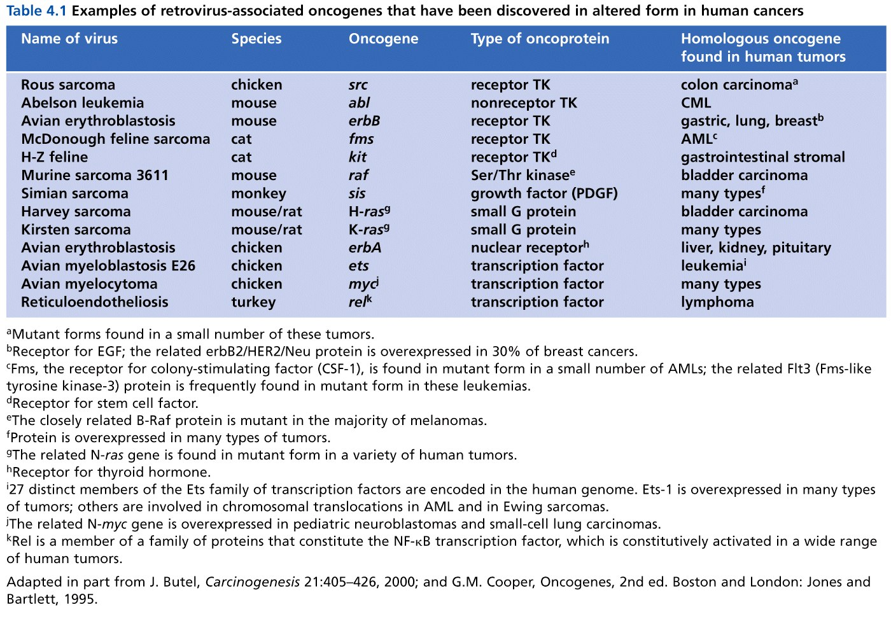
Table 4.1 The Biology of Cancer (© Garland Science 2007)

Slide 33
So how can the proto-oncogene like RAS become an oncogene?
What types of alterations would you expect in oncogenes? Recall the general role of oncogenes in the cell cycle?
Mutations in oncogenes are typically gain of function.

Slide 34
Several mechanisms
1. Point mutation:
Most RAS oncogenes in human cancers, have only one nucleotide substitution compared to the normal RAS sequence.
The only difference in the oncogenic Ras protein and the normal Ras protein is a single amino acid change. Figure 9-1

Slide 35
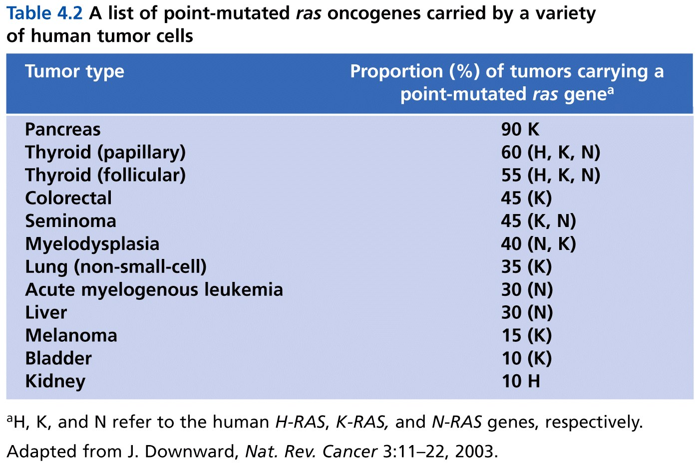
Table 4.2 The Biology of Cancer (© Garland Science 2007)

Slide 36
Some carcinogens (cancer causing mutagens) seem to target specific oncogenes, like RAS with point mutations.
Asbestos
Vinyl chloride
DMBA

Slide 37
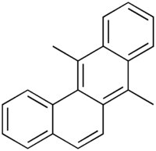
7,12-dimethylbenzo[b]phenanthrene
DMBA= one of the most potent, organ-specific tumor initiators used in cancer studies. Induces mammary tumors in rodents. Why/how? Point mutation in Ras.

Slide 38
AROMATIC AZO DERIVATIVES PREVENTING MAMMARY
CANCER AND ADRENAL INJURY FROM
7,12-DIMETHYLBENZ(a)ANTHRACENE*
BY CHARLES HUGGINS AND JOHN PATAKI
THE BEN MAY LABORATORY FOR CANCER RESEARCH, UNIVERSITY OF CHICAGO
Communicated February 18, 1965

Slide 39
Charles Huggins won a Nobel prize (1966) for his work on breast cancer. He was among the first to identify a link between hormones and tumors/tumor progression.
He shared the prize with Peyton Rous who independently discovered tumor-inducing viruses! (Rous sarcoma virus and the src gene)

